Slide 1

Department of Artificial Intelligence and Data Science
NeuroDetect: An AI-Powered Dementia Predicting System
Mrs. R. Savithri
TEAM 15
Geetha G (221801011)
Shanmugashree M (221801049)

Slide 2
Problem Statement and Motivation
Dementia often goes undiagnosed in its early stages due to subtle cognitive decline, leading to delayed treatment and poorer outcomes. Existing screening tools are costly, device-dependent, or limited in scope and language support, which restricts their accessibility and effectiveness.
To address this gap, there is a need for a low-cost, multilingual AI-based system that can analyze speech, cognition, and behavioural patterns to detect early signs of dementia. Such a solution should enable continuous monitoring, generate explainable risk scores, and support timely clinical referral. By integrating these features, the tool can provide a holistic, inclusive, and accessible approach to dementia detection, ultimately improving early diagnosis, medical intervention, and quality of care for patients.

Slide 3
Existing System
Dementia is mostly checked using tests like MMSE and MoCA, which must be done by doctors and cannot be done alone by users.
Many diagnoses depend on brain scans such as MRI or CT, which are expensive and not suitable for regular screening.
Early symptoms are often missed because doctors rely on patients or family members to report changes, which may not always be accurate.
Existing systems usually study only one type of data (like memory tests or scans), so early speech or language changes are not detected.
Most screening methods require visiting hospitals or clinics, making early detection difficult for people in rural or remote areas.

Slide 4
Objectives
The objective of this project is to design and develop a low-cost, accessible, and multilingual AI-based screening tool that can analyze speech, cognitive tasks, and behavioural patterns to detect early signs of dementia. The system aims to establish individual baselines, continuously monitor deviations, generate explainable risk scores, and provide timely clinical referrals. By integrating multimodal assessments with secure data handling and vernacular support, the project seeks to improve early detection, accessibility, and quality of dementia care.

Slide 5
Abstract
Dementia is a progressive neurodegenerative disorder that often remains undiagnosed in its early stages due to subtle cognitive decline, leading to delayed interventions and poor outcomes. Existing screening systems are costly, device-dependent, or lack language inclusivity, limiting their reach. This project proposes a low-cost, multilingual AI-based tool that analyzes speech, cognitive tasks, and behavioural patterns to detect early dementia. The system establishes individual baselines, supports continuous monitoring, and generates explainable risk scores for timely clinical referral. By integrating multimodal assessments with secure data management and vernacular support, the solution aims to improve early diagnosis, accessibility, and quality of dementia care.

Slide 6
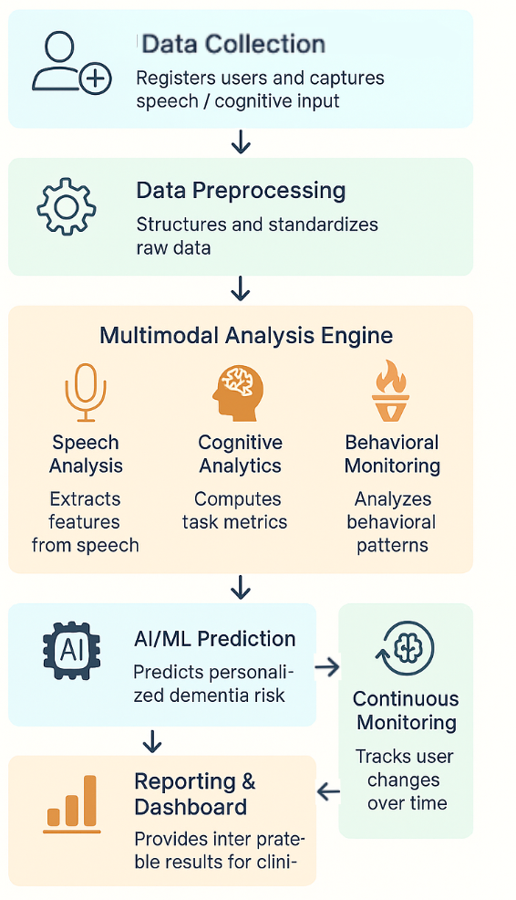
Architecture(Framework)

Slide 7
Modules
1. User Registration Module - Manages user profiles, demographic info, and secure authentication.
2. Speech Analysis Module - Converts speech to text and extracts features like tone, pitch, and emotion.
3. Cognitive Test Module - Provides tasks like memory games, problem-solving, and attention tests.
4. Behavioural Monitoring Module - Tracks task completion speed, accuracy, and consistency over time.
5. AI Prediction Module - Uses multimodal data to predict dementia risk using trained ML/DL models.
6. Multilingual Support Module - Ensures system accessibility in regional languages.

Slide 8
Conclusion
The implemented system focuses on the Speech Recognition Module of NeuroDetect, which analyzes a user’s speech to identify potential early signs of dementia. By using the OpenAI Whisper API, along with LSTM and CNN-LSTM models, the module extracts meaningful acoustic and linguistic patterns such as speech rate, pauses, fluency, and word retrieval difficulty. These indicators offer valuable insights into early cognitive changes, enabling quick, non-invasive screening without the need for clinical equipment. The module supports remote assessment, making it especially helpful for elderly users and those in rural areas.

Slide 9
Thank You

